Slide 1

Critical factors for strategic business improvement success
Maintenance, Engineering Services and Technology Management Conference
2 June 2010
Dr James A Robertson PrEng
James@JamesARobertson.com
Notes:
NB remember to have a chair to stand on
Make sure to take the CRITICAL FACTORS BOOK with you
An engineer with a PhD in engineering

Slide 2
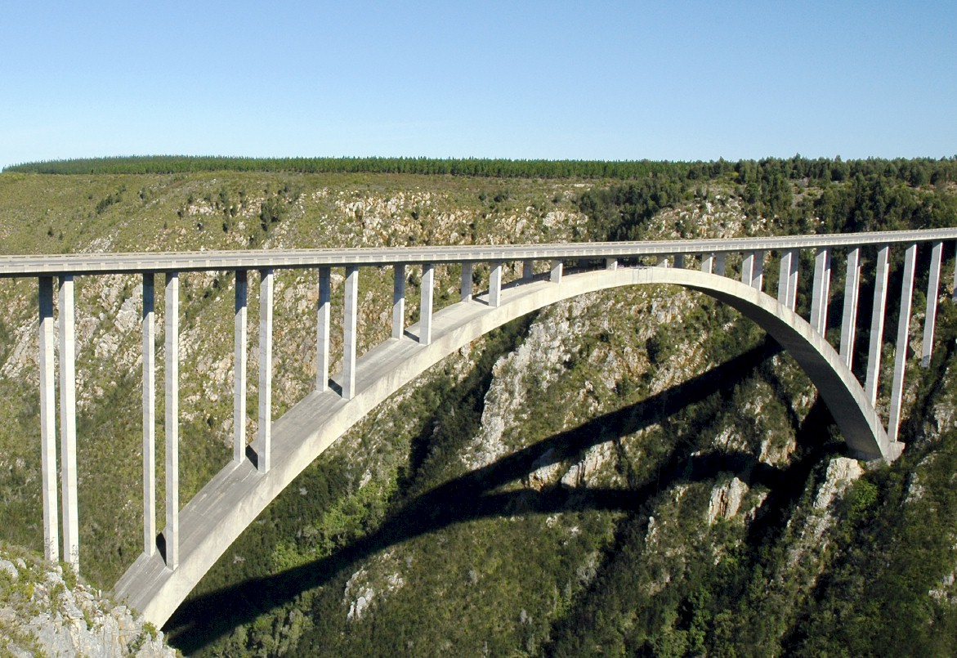
Business improvement versus bridges
Notes:
In considering what i have learned as an engineer with considerable experience of the practical application of information technology i eventually realized about ten years ago that
ENGINEERS DO NOT DESIGN BRIDGES TO STAND UP – click

Slide 3
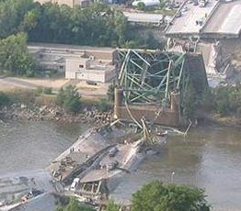
Engineers do NOT design bridges to stand up
Notes:
Who remembers this bridge collapse in Minneapolis in the middle of 2007? Within minutes it was front page news around the world – we do NOT expect bridges to fall down – if we did there would not have been anyone on that bridge that day!

Slide 4
Engineers design bridges NOT to fall down
Notes:
There is a fundamental difference in approach when one designs a bridge NOT TO FALL DOWN
Contrast this with the IT paradigm which could be called “designed to fail”

Slide 5
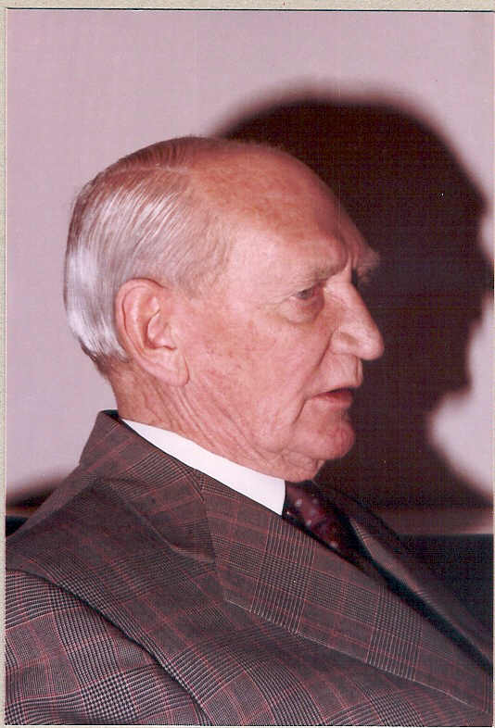
Vision
Angus Struan Robertson
Notes:
KEEP SHORT AND SIMPLE
MY FATHER
How did i get involved with computers? – my father was a visionary -- In 1981, having gathered over 7,000 pages of research data for my PhD the University mainframe did not have space to store even one page of data. My father purchased me one of the first desktop PC’s in the days of the Apple and Apricot and 123, etc – at a cost of R12,000 two and a half times my research grants! – I very quickly discovered that there was a HUGE gap between what the salesman told me the computer could do and getting it to do it – so, in that respect, NOTHING HAS CHANGED ☺ -- I then put myself through a self taught computer science programme and learned to program, learned to type and finally wrote an award winning PhD thesis – at the same time I computerized my father’s investment consulting business and we were able to double turnover in twelve months and create an enduring revenue stream that lasted for over ten years because we were able to do things that much larger businesses were not able to do – it was then that I began to understand that the strategic application of information technology COULD deliver great value and one of my greatest frustrations is the extent to which few businesses achieve this potential – the rest of this presentation is about lessons I have learned that I hope will help YOU to make a difference in your business with IT

Slide 6

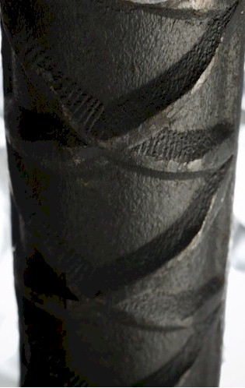
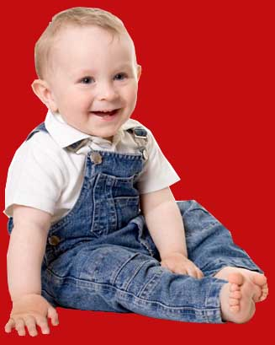

Experiencing failure

Slide 7

What is strategy?

Slide 8
Strategy
Doing the right things
Professor Malcolm McDonald

Slide 9
Tactics
Doing things right
Professor Malcolm McDonald

Slide 10
Strategy versus tactics
Tactics – Doing things right ➔
Strategy – Doing the right things ➔
Professor Malcolm McDonald

Slide 11

Strategy versus tactics
Thrive
Tactics – Doing things right ➔
Strategy – Doing the right things ➔

Slide 12
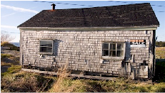
Strategy versus tactics
Tactics – Doing things right ➔
Survive
Strategy – Doing the right things ➔

Slide 13
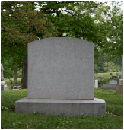
Strategy versus tactics
Tactics – Doing things right ➔
Die
Strategy – Doing the right things ➔

Slide 14


Strategy versus tactics
Die fast
Tactics – Doing things right ➔
Die slowly
Strategy – Doing the right things ➔

Slide 15
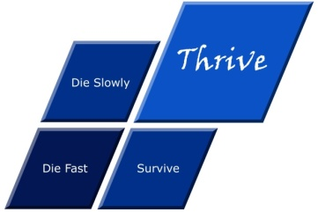
Strategy versus tactics
Die fast
Thrive
Tactics – Doing things right ➔
Die slowly
Survive
Strategy – Doing the right things ➔

Slide 16
What is strategy?
The essence of why an organization exists and how it thrives

Slide 17
Infrastructure maintenance
An industry in crisis
Roads R75 billion
Water supply, massive drought driven shortage looming
Electricity – supply failures again …?
Sewerage filled rivers
Electricity reticulation quietly decaying
etc
Notes:
KEEP SHORT AND SIMPLE
MY FATHER
How did i get involved with computers? – my father was a visionary -- In 1981, having gathered over 7,000 pages of research data for my PhD the University mainframe did not have space to store even one page of data. My father purchased me one of the first desktop PC’s in the days of the Apple and Apricot and 123, etc – at a cost of R12,000 two and a half times my research grants! – I very quickly discovered that there was a HUGE gap between what the salesman told me the computer could do and getting it to do it – so, in that respect, NOTHING HAS CHANGED ☺ -- I then put myself through a self taught computer science programme and learned to program, learned to type and finally wrote an award winning PhD thesis – at the same time I computerized my father’s investment consulting business and we were able to double turnover in twelve months and create an enduring revenue stream that lasted for over ten years because we were able to do things that much larger businesses were not able to do – it was then that I began to understand that the strategic application of information technology COULD deliver great value and one of my greatest frustrations is the extent to which few businesses achieve this potential – the rest of this presentation is about lessons I have learned that I hope will help YOU to make a difference in your business with IT

Slide 18
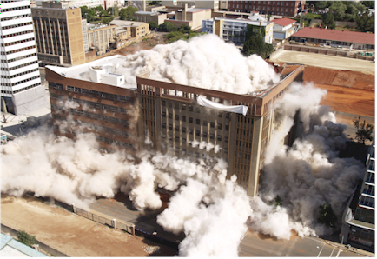
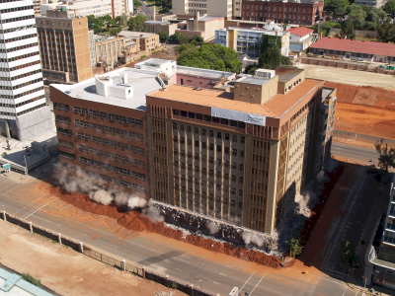
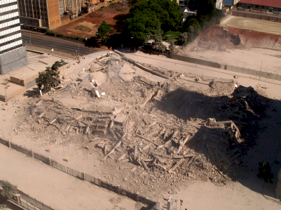
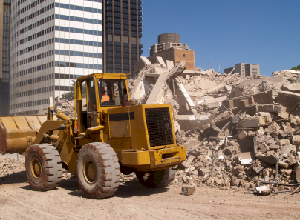
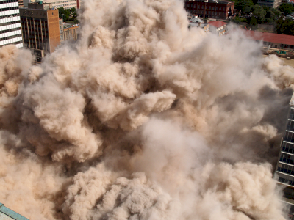

Maintain or …?
Notes:
DHL, Prochem,

Slide 19
Accountability for maintenance
Governance = Care!
Mervyn King
Board is responsible for technology maintenance

Slide 20
Question
Does maintenance or technology management failure constitute a threat to your business today?

Slide 21
There is a need for a new approach
Notes:
There is a fundamental difference in approach when one designs a bridge NOT TO FALL DOWN

Slide 22
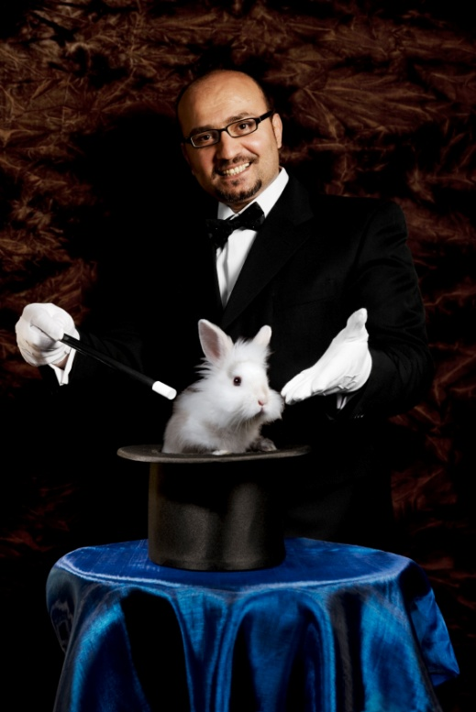

What is NOT an engineering approach?
Notes:
What is not an engineering approach? – Dramatically walk to chair – did this ever happen to you? –
WHEN SLEEPING
when i was a child i used to dream that i would stand on a chair and flap my arms and fly around the room --i have to say that that is NOT an engineering approach – as much as i may be convinced i can fly i have to say to you that were i to stand on top of a skyscraper and flap my arms and jump i would hit the ground at great speed and almost certainly die – that is NOT an engineering approach and yet many seem to think they can use software to do things magically – many are hypnotized and mesmerized by IT – are you? CLICK for rabbit out of the hat

Slide 23
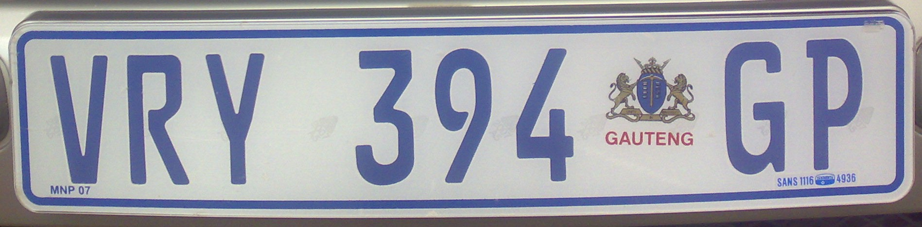

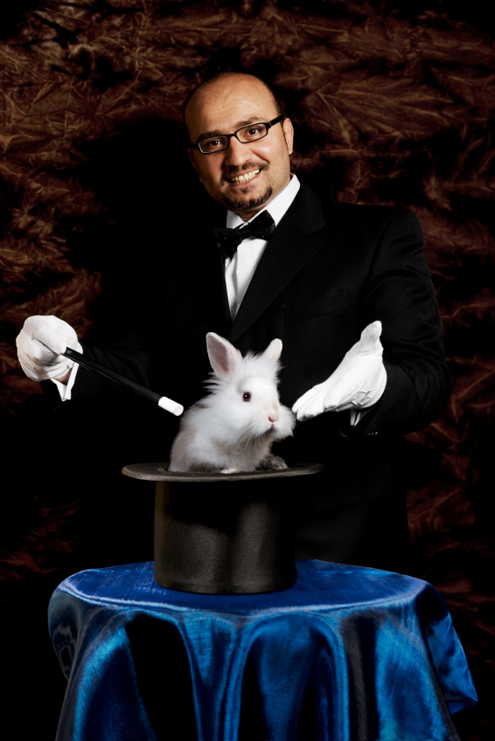
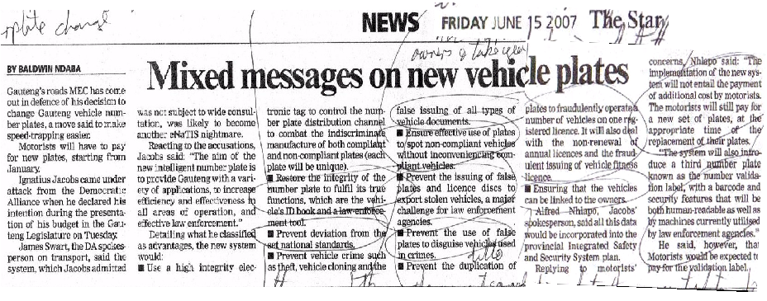
The new Gauteng numberplate with microchip
+
=
?
“Restore the integrity of the number plate to fulfil its true functions which are the vehicle’s ID book and a law enforcement tool.“
Notes:
Over the years my research led to some useful insights
Do not be mesmerized by technology or hype
Do NOT abdicate your intellect!
PUNCHY

Slide 24
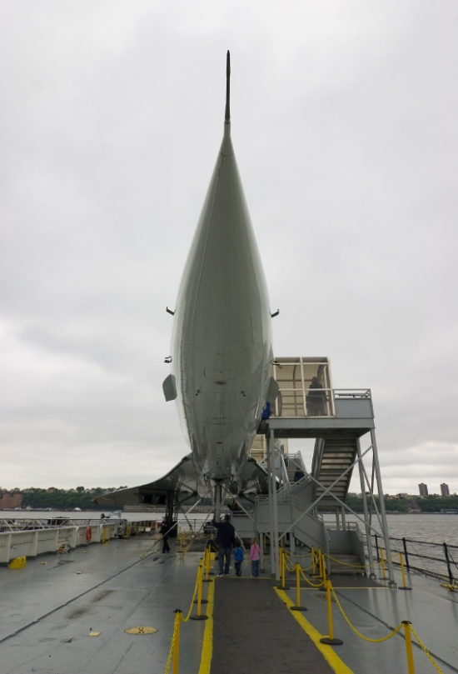
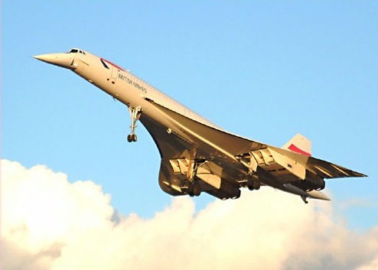


Is technology moving so fast you cannot keep up?
Notes:
You CAN keep up with technology
Make technology slow down to the pace that suits your business
Relevant technology that works
GESTURES
Do you remember the Concorde? – Johannesburg to London in three hours? – BUT the people on the ground were not prepared to tolerate the BOOMMMMMMMMMMM as the plane travelled at supersonic speed so it never took off commercially, only 20 were built and one crashed owing to a design flaw and the last planes today are sitting in museums
Then there was the Boeing 747 – designed almost by accident – tell the story
So, is IT moving so fast – not really – the big question is whether Windows Vista is the Concorde of IT

Slide 25
Question
Why do technology maintenance and management investments fail?

Slide 26
Factors causing IT failure
Notes:
NB People
KEEP IT SHORT

Slide 27


The value of technology is determined by the person using the technology
Notes:
A gun is neither good nor bad
If it is held by a person you regard as good and pointed at a person you regard as bad the gun is good
BUT if it is pointed at YOU it is always BAD!

Slide 28
People and technology alignment
High frustration
Performance
improvement
Empowerment
Commitment
Ownership
Experience
Knowledge
Participation
Consultation
Information
P
eople
High risk
Technology
Methods
Strategic objectives
Systems
Structures and processes
After Dr Fritz Hölscher

Slide 29
Question
How to fix deficient maintenance and technology management initiatives?

Slide 30
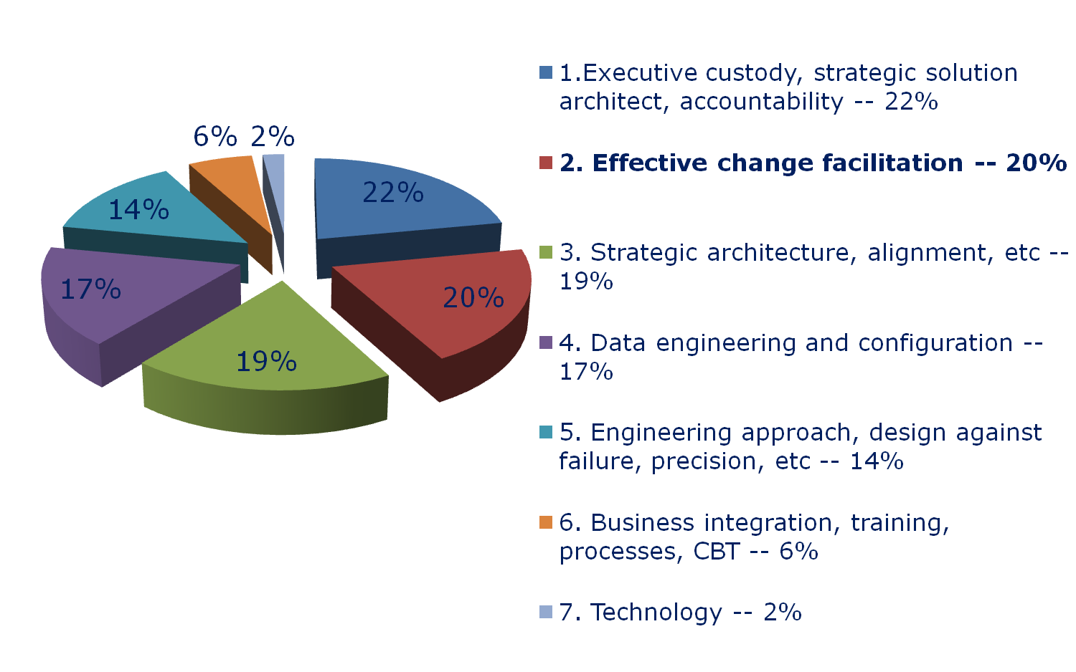
Factors for ERP reimplementation success

Slide 31


Leadership
Executive custody is critical
  -- 50% leadership
Notes:
Make it work
It is all in a name

Slide 32
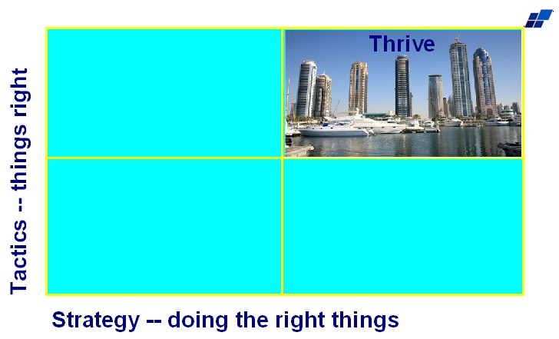

Strategic alignment
Essence of why the business exists and how it thrives

Slide 33
Call to action
What is your single most important insight from this presentation?
What is the single most practical action that you can take tomorrow to apply I.T. more effectively?

Slide 34

If you do not act within 48 hours you probably never will – act TODAY! ☺
James@JamesARobertson.com
Telephone: ++27-(0)83-251-6644

Slide 35

Design maintenance solutions like bridges ...
Not to fall down and to last

Slide 36

Acknowledgements
Clients, associates, staff
Father and mother, Angus and Thelma
Children Alexandra and Struan
Fiona and Ingrid
Psalm 136:5 "To Him who by wisdom made the heavens, for His mercy endures forever;"

Slide 37
Questions?
Dr James Robertson PrEng
James A Robertson & Associates
Telephone: ++27-(0)86-111-5409 /
++27-11- 782-5996/7
Cell: ++27-(0)83-251-6644 (preferred)
Fax: ++27-(0)86-540-0178
P O Box 4206, Randburg, 2125,
South Africa
www.JamesARobertson.com
email: James@JamesARobertson.com
Finding the missing pieces of your I.T. and strategy puzzles

Slide 38
Notes:
WHAT CAUSES IT FAILURE?
Since 1993, analysed in 2003, course, book
Sustainable versus experimentation
People
The factors causing IT failure – in 1993 I became aware of the high failure rate of IT projects and started to talk about it – as a consequence i was asked to investigate many failed or failing projects and to help to turn them around – over the years i built up a large catalogue of the factors causing failure – in 2003 i undertook a critical issues analysis of the factors causing failure and arrived at a list of seven critical factors causing failure together with the critical factors for success which then became the subject of a course and subsequently a book – HOLD UP THE BOOK – since then i have advised many clients and led a number of significant projects and consistently validated the basic analysis
The biggest single factor causing failure is Mythology at 30% followed by lack of executive custody and inappropriate governance at 25%

